Slide 1

Introduction to machine Learning

Slide 2
What is Machine Learning?
“Learning is any process by which a system improves performance from experience.”
- Herbert Simon: Nobel prize in Economics(1979)
Definition by Tom Mitchell (1998):founder the Machine Learning Department at CMU
Machine Learning is the study of algorithms that
improve their performance P
at some task T
with experience E.
A well-defined learning task is given by <P, T, E>.

Slide 3

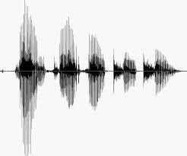
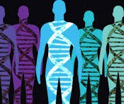
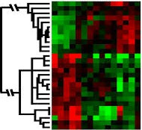
When Do We Use Machine Learning?
ML is used when:
Human expertise does not exist (navigating on Mars)
Humans can’t explain their expertise (speech recognition)
Models must be customized (personalized medicine)
Models are based on huge amounts of data (genomics)
Learning isn’t always useful:
There is no need to “learn” to calculate payroll

Slide 4
State of the Art Applications of Machine Learning

Slide 5
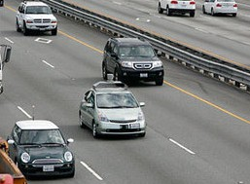
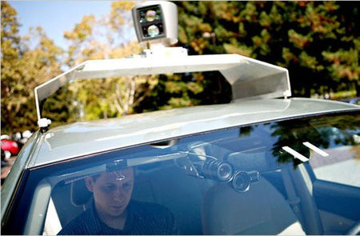
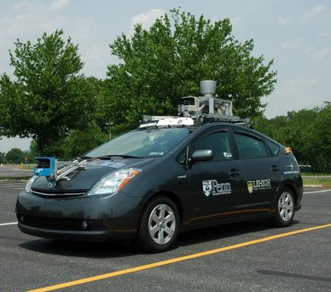
Autonomous Cars

Slide 6
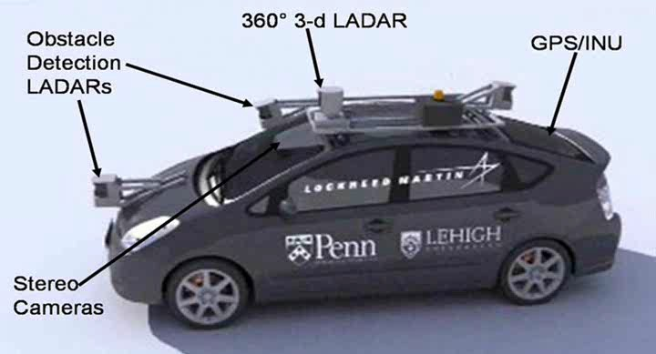
Autonomous Car Sensors

Slide 7
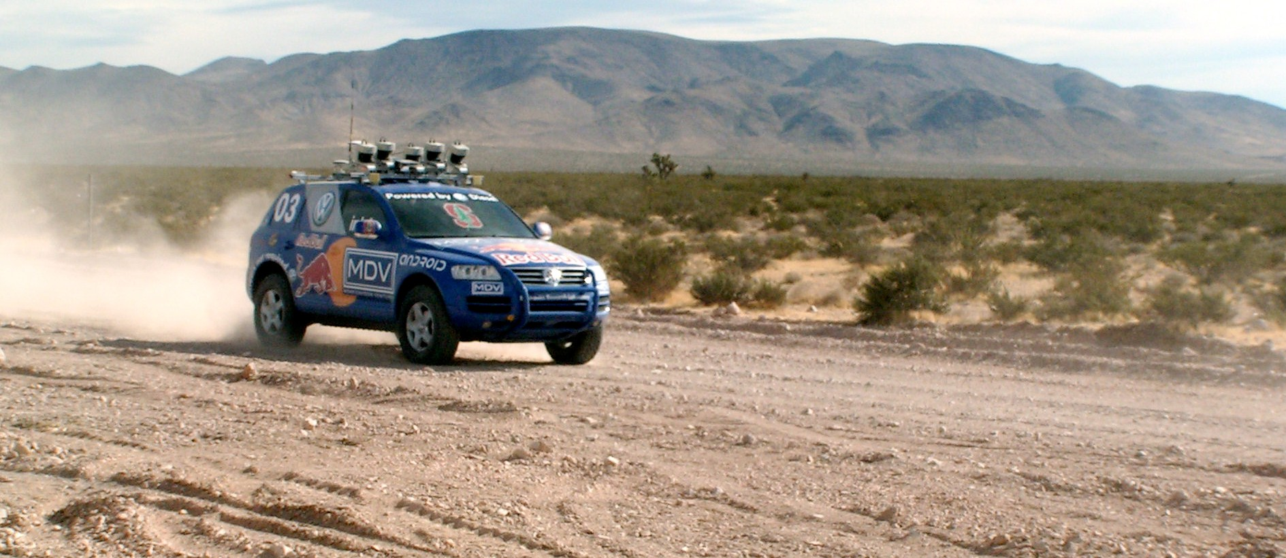
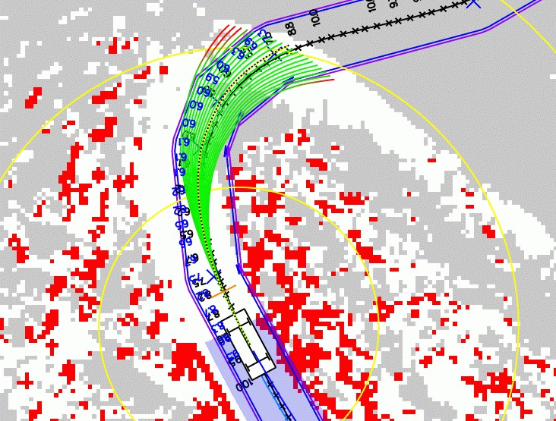
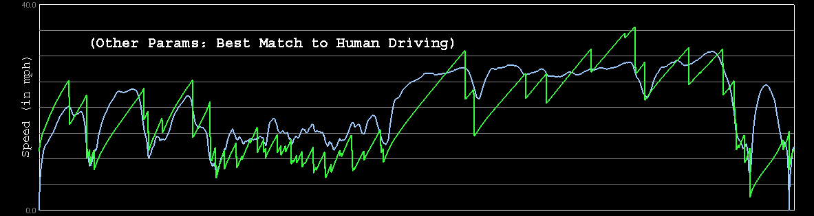

Autonomous Car Technology
Path Planning
Laser Terrain Mapping
Learning from Human Drivers
Sebastian
Adaptive Vision
Stanley

Slide 8


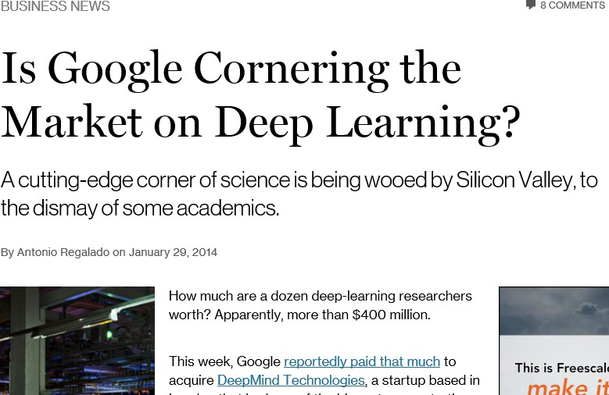
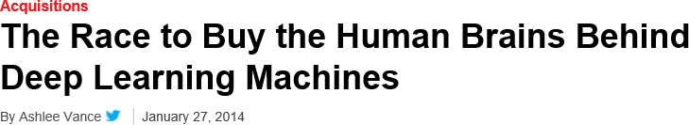
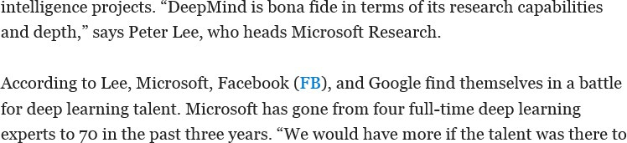
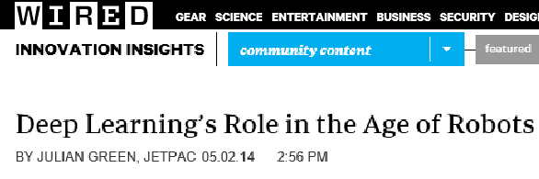
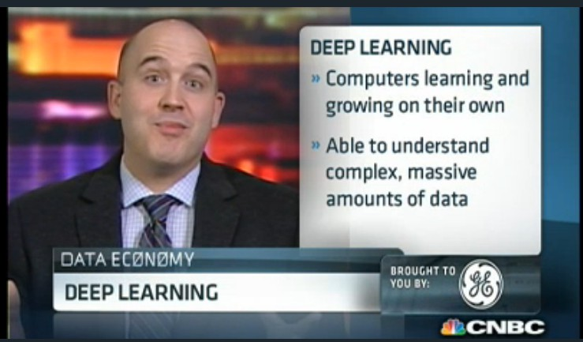
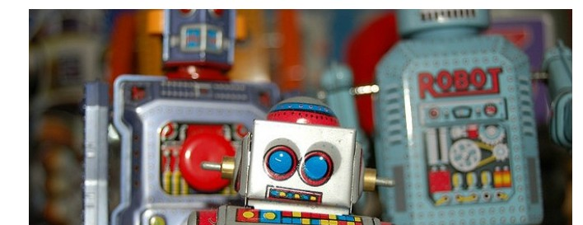
Deep Learning in the Headlines
15

Slide 9
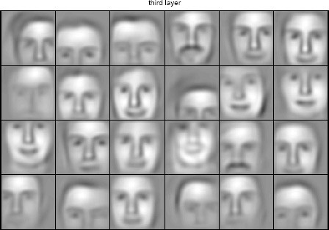
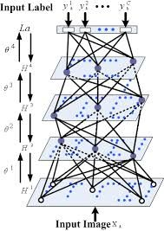

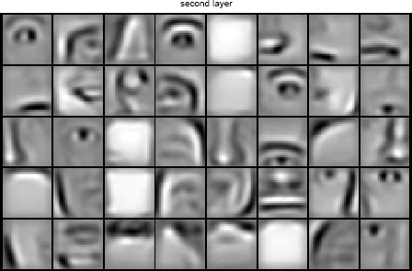


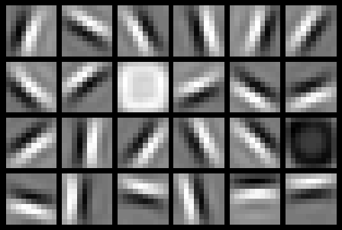
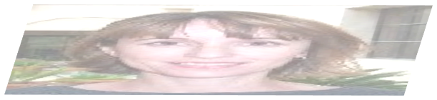



Deep Belief Net on Face Images
object models
object parts (combination of edges)
edges
pixels

Slide 10
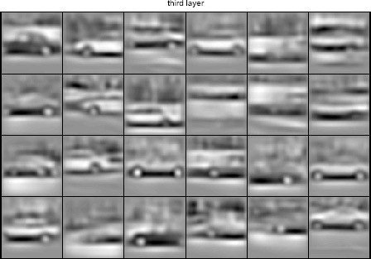
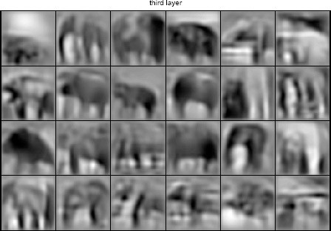
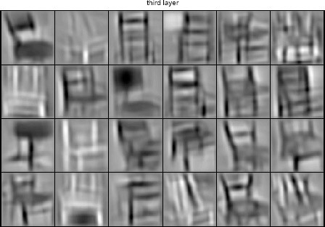
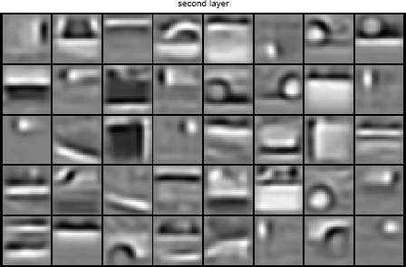
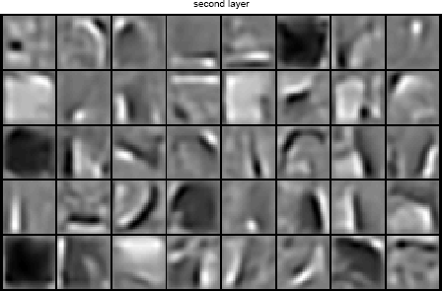
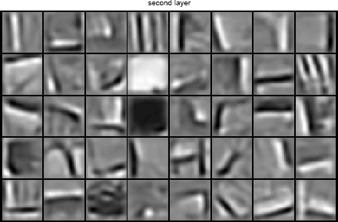
Learning of Object Parts

Slide 11
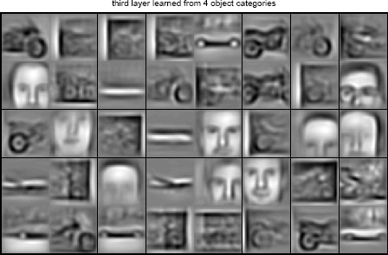
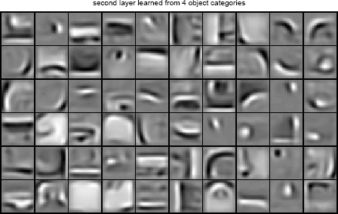
Training on Multiple Objects
Trained on 4 classes (cars, faces, motorbikes, airplanes).
Second layer: Shared-features and object-specific features.
Third layer: More specific features.

Slide 12
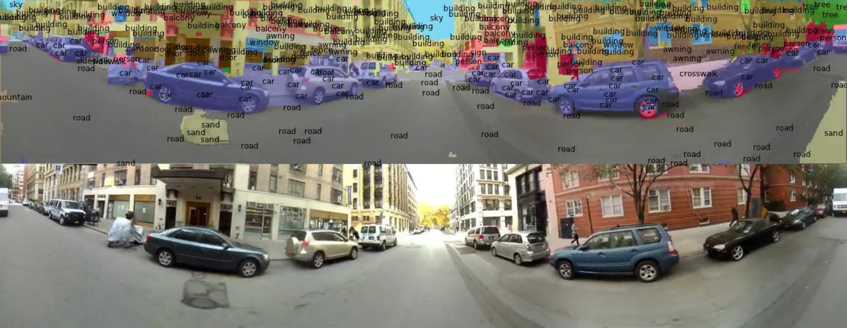
Scene Labeling via Deep Learning

Slide 13
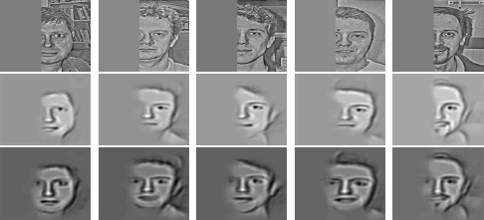
Inference from Deep Learned Models
Generating posterior samples from faces by “filling in” experiments
(cf. Lee and Mumford, 2003). Combine bottom-up and top-down inference.
Input images
Samples from feedforward Inference (control)
Samples from Full posterior inference

Slide 14
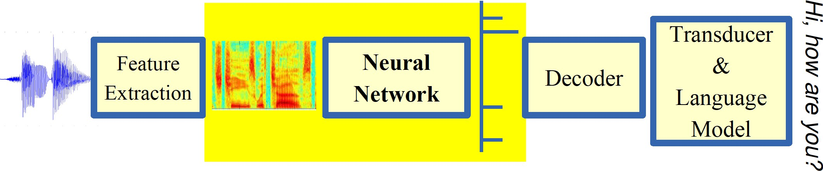
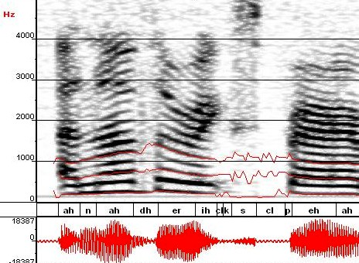
Machine Learning in Automatic Speech Recognition
A Typical Speech Recognition System
ML used to predict of phone states from the sound spectrogram
Deep learning has state-of-the-art results
# Hidden Layers | 1 | 2 | 4 | 8 | 10 | 12
Word Error Rate % | 16.0 | 12.8 | 11.4 | 10.9 | 11.0 | 11.1
Baseline GMM performance = 15.4%
[Zeiler et al. “On rectified linear units for speech recognition” ICASSP 2013]

Slide 15

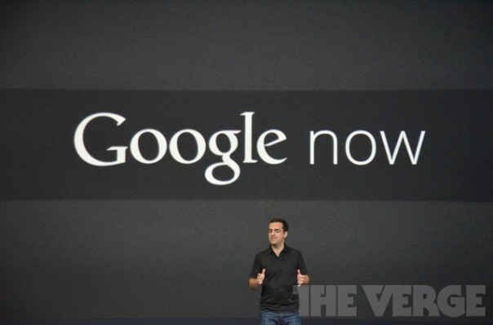
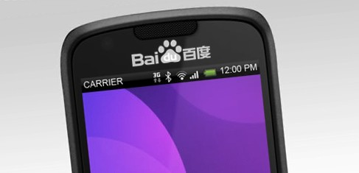
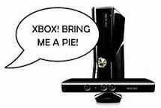



Impact of Deep Learning in Speech Technology

Slide 16
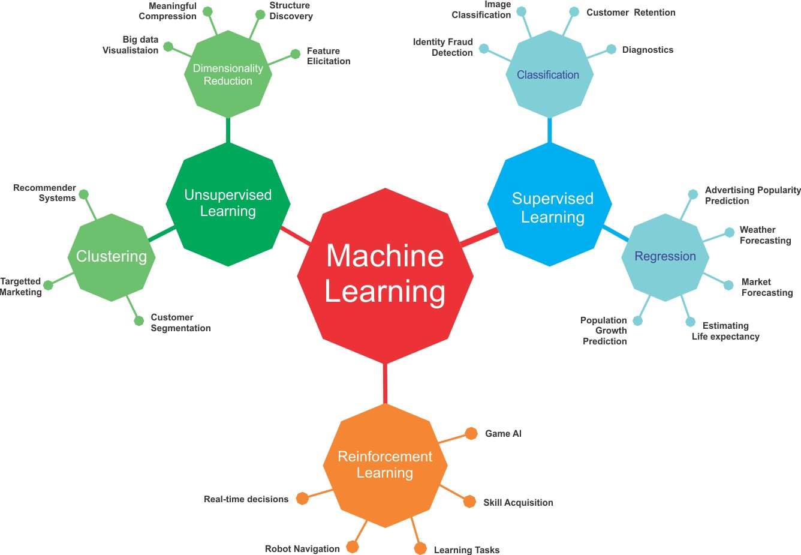
ML-Basics: What is Machine Learning?
Learning goals
Understand basic terminology of and connections between ML, AI, DL and statistics
Know the main directions of ML: Supervised, Unsupervised and Reinforcement Learning

Slide 17
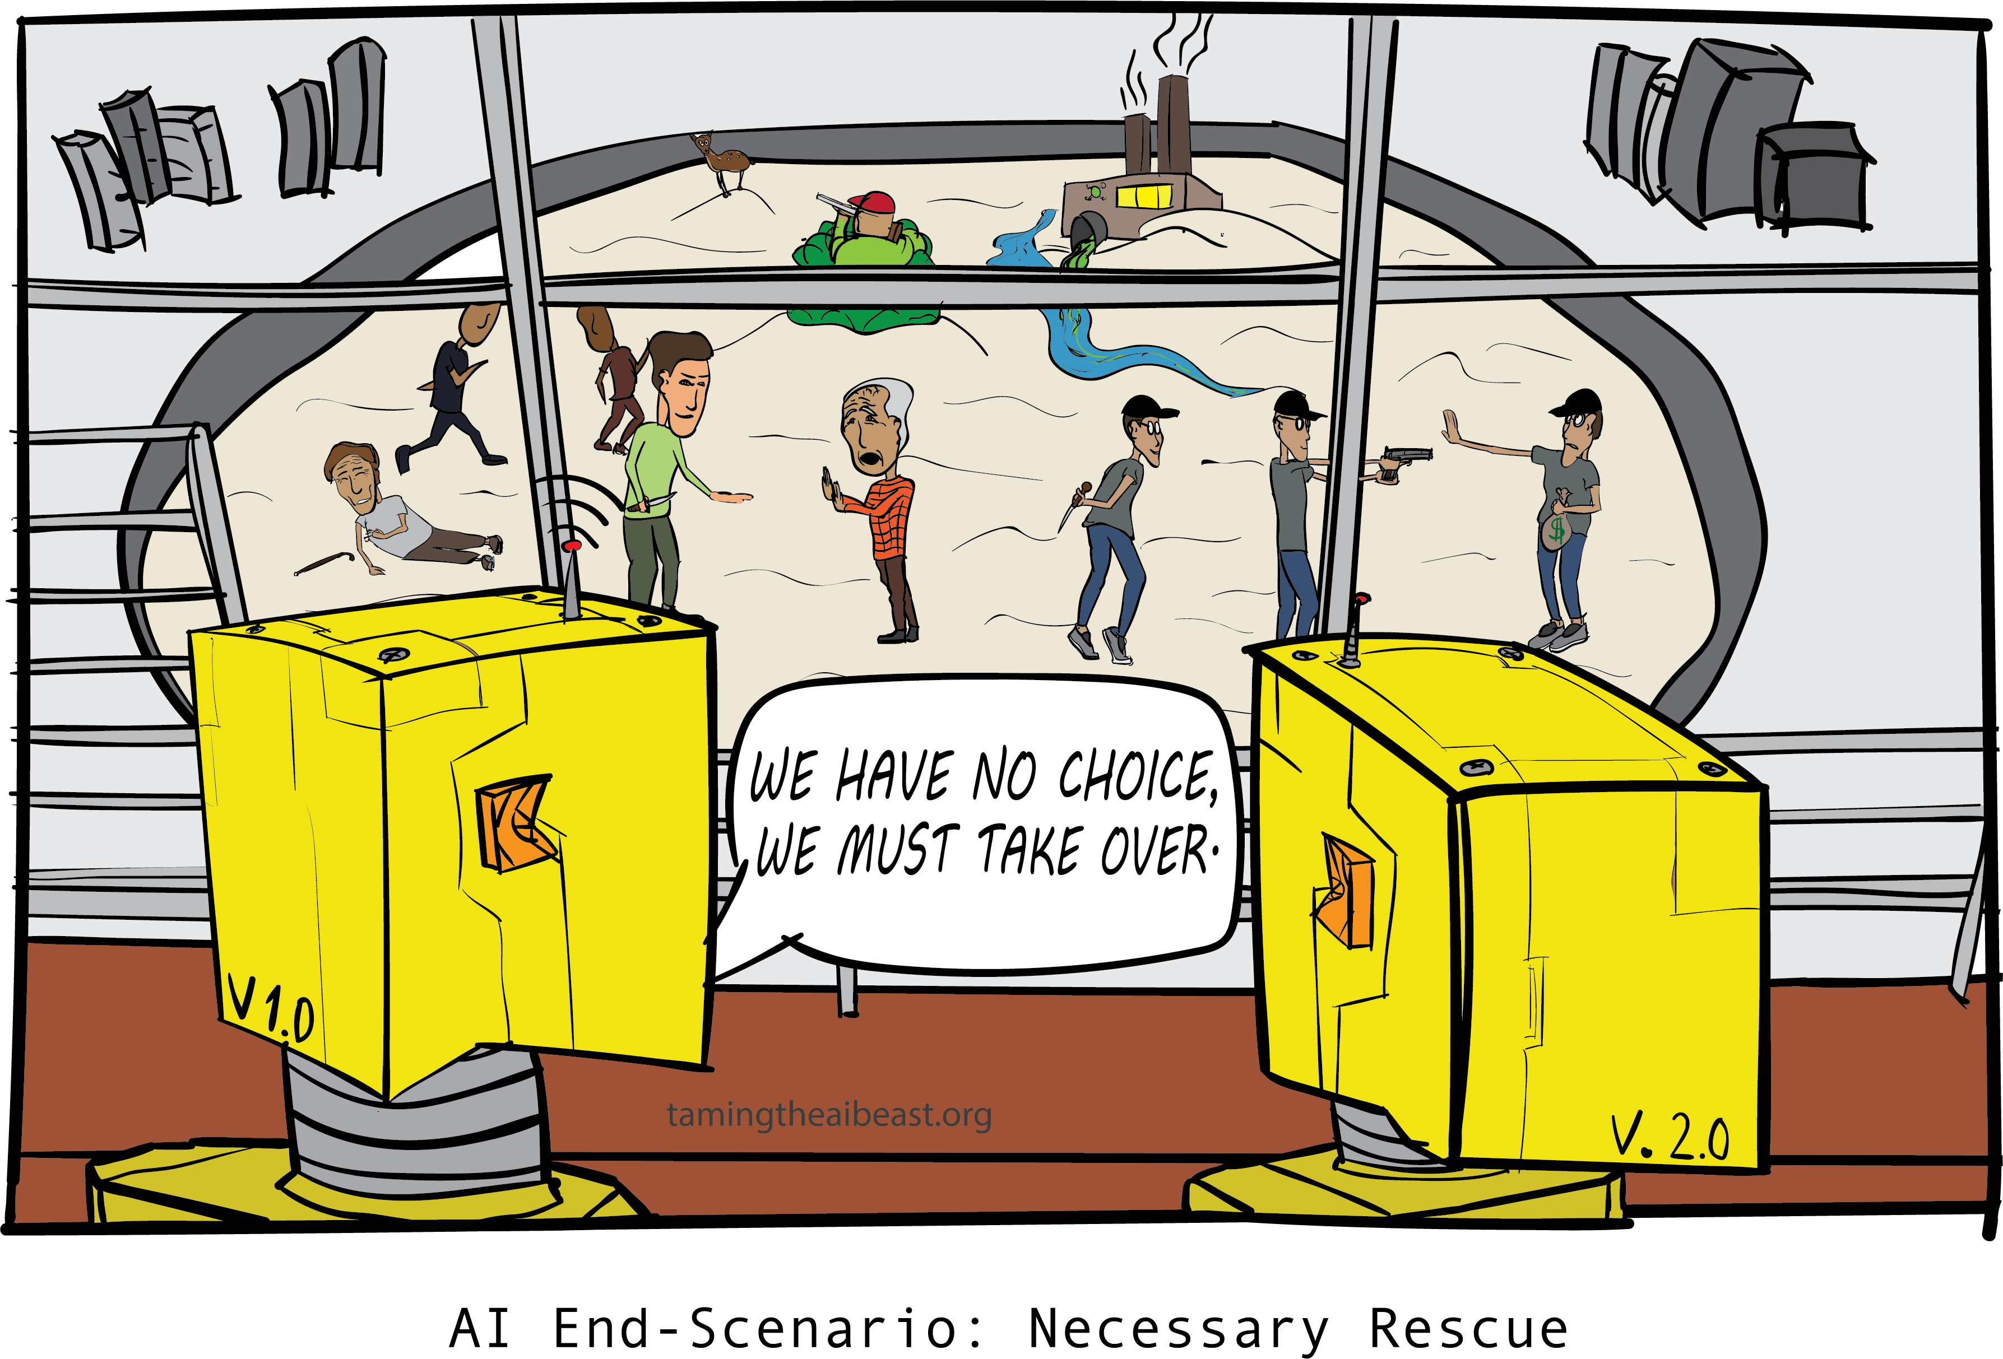
ML IS CHANGING OUR WORLD
Search engines learn your search preferences
Recommender systems learn your taste in books, music, movies,... Algorithms do automatic stock trading
Tools can accurately translate between many different languages DeepMind beats humans at Go
Physicians are supported by personalized medicine
LLMs revolutionize many fields (currently especially coding) Data-driven discoveries are made in physics, biology, genetics, astronomy, chemistry, neurology,...
...

Slide 18
AI, ML AND DL
Artificial Intelligence
Machine Learning
Deep Learning
Many people are confused what these terms actually mean.
And what does all this have to do with statistics?

Slide 19

ARTIFICIAL INTELLIGENCE
General term for very large and rapidly developing field.
No strict definition, but often used when machines perform tasks that could only be solved by humans or are very difficult and assumed to require “intelligence”.
Started in the 1940s – when the computer was invented. Turing and von Neumann immediately asked: If we can formalize computation, can we use that to formalize “thinking”?
Includes ML, NLP, computer vision, robotics, planning, search, intelligent agents, ...
Sometimes misused as a “hype” term for ML or ... basic data analysis.
Or people refer to the fascinating developments in the area of foundation models

Slide 20
MACHINE LEARNING
Mathematically well-defined and solves reasonably narrow tasks.
Usually construct predictive models from data, instead of explicitly programming them.
“A computer program is said to learn from experience E with respect to some task T and some performance measure P, if its performance on T, as measured by P, improves with experience E.”
Tom Mitchell, Carnegie Mellon University, 1998

Slide 21

DEEP LEARNING
Subfield of ML which studies neural networks.
Artificial neural networks are roughly inspired by the human brain, but we treat them as useful, mathematical models.
Studied for decades (start in the 1940/50s).Uses more layers, might use specific neurons, e.g., for images, many computational improvements to train on large data.
Can be used on tabular data, but typical applications are images, texts or signals.
Last 15-20 years have produced remarkable results and imitations of human ability, where the result looked intelligent.
“Any sufficiently advanced technology is indistinguishable from magic.” Arthur C. Clarke’s 3rd law

Slide 22
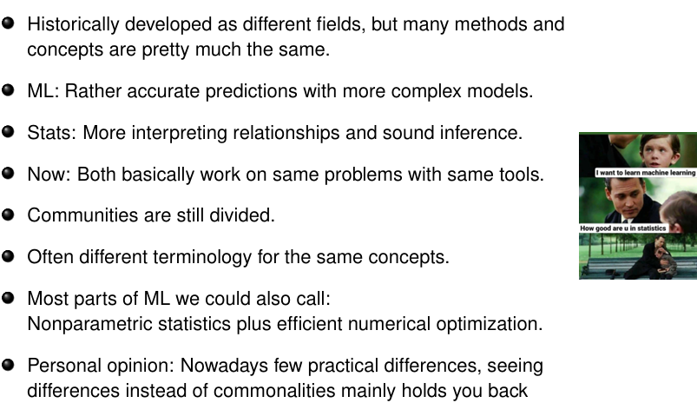
ML VS. STATS

Slide 23
Types of Learning

Slide 24
Types of Learning
Supervised (inductive) learning
Given: training data + desired outputs (labels)
Unsupervised learning
Given: training data (without desired outputs)
Semi-supervised learning
Given: training data + a few desired outputs
Reinforcement learning
Rewards from sequence of actions

Slide 25



Supervised Learning: Regression
Given (x₁, y₁), (x₂, y₂), ..., (x_{n}, y_{n})
Learn a function f(x) to predict y given x
– y is real-valued == regression
9
8
7
6
5
4
3
2
1
0
1970 1980
September Arctic Sea Ice Extent (1,000,000 sq km)
1990 2000
2010
2020
Year

Slide 26










Supervised Learning: Classification
Given (x₁, y₁), (x₂, y₂), ..., (x_{n}, y_{n})
Learn a function f(x) to predict y given x
– y is categorical == classification
Breast Cancer (Malignant / Benign)
1(Malignant)
0(Benign)
Tumor Size

Slide 27








Supervised Learning: Classification
Given (x₁, y₁), (x₂, y₂), ..., (x_{n}, y_{n})
Learn a function f(x) to predict y given x
– y is categorical == classification
Breast Cancer (Malignant / Benign)
1(Malignant)
0(Benign)
Tumor Size
Predict Benign Predict Malignant
Tumor Size

Slide 28











Supervised Learning
x can be multi-dimensional
– Each dimension corresponds to an attribute
Clump Thickness
Uniformity of Cell Size
Uniformity of Cell Shape
…
Age
Tumor Size

Slide 29
















Unsupervised Learning
Given x₁, x₂, ..., x_{n} (without labels)
Output hidden structure behind the x’s
– E.g., clustering

Slide 30
UNSUPERVISED LEARNING
Data without labels y
Search for patterns within the inputs x
Unsupervised as there is no “true” output we can optimize against
2.5
● ●●●
Dimensionality reduction (PCA, autoencoders ...);
compress information in X
Clustering: group similar observations
Outlier detection, anomaly detection
Association rules
●●●●●●●● ●
●●●● ●
●●●●●●● ●
2.0
●●
●●●●●●●●●
●●●
● ●
Petal.Width
●●● ●
1.5
●●●●●●
● ●●● ●
●●●●●●●
●
●●●●●●
1.0
●●●●●●
●
0.5
●
●●●●●
●●●●●●●●●●
0.0
●●●
2
4
Petal.Length
6

Slide 31
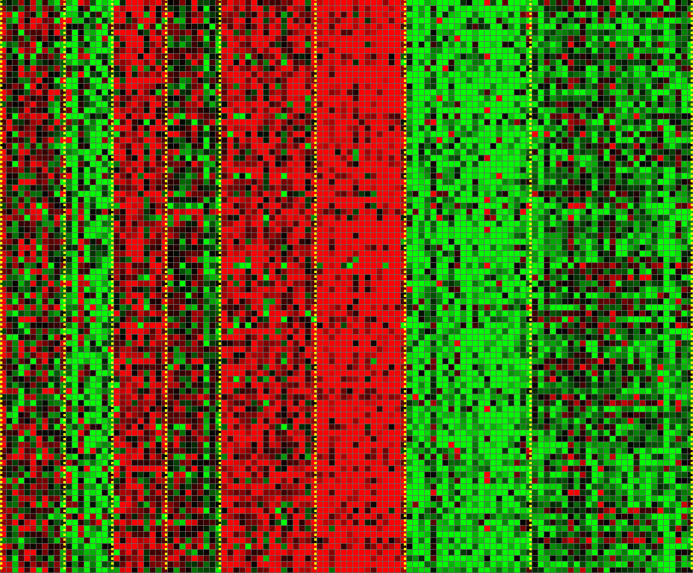
Unsupervised Learning
Genomics application: group individuals by genetic similarity
Genes
Individuals

Slide 32

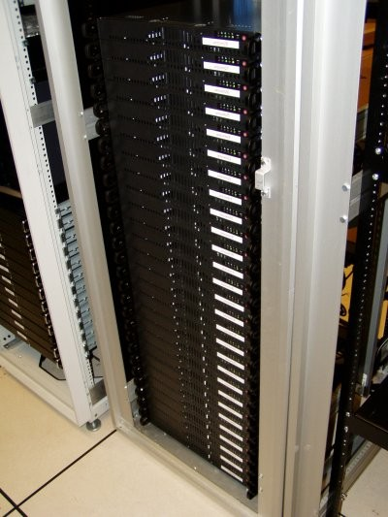
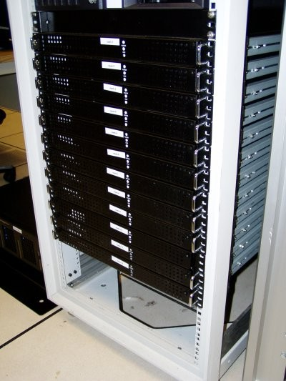




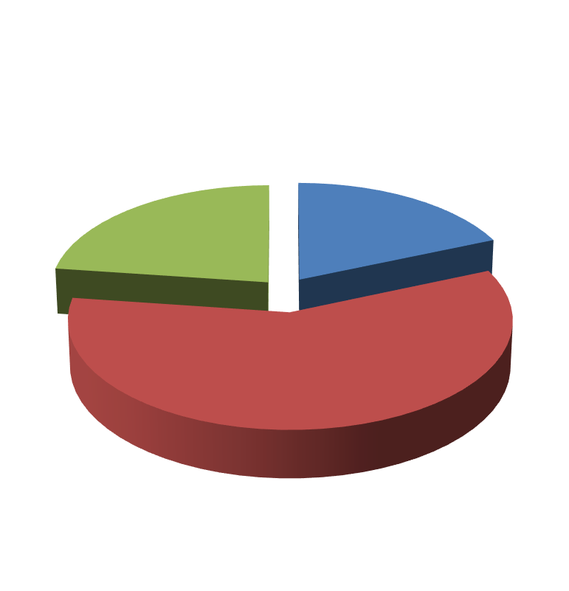

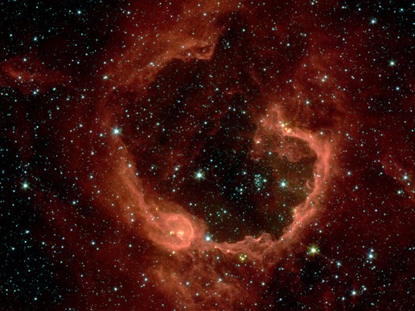


Unsupervised Learning
Organize computing clusters
Social network analysis
Market segmentation
Image credit: NASA/JPL-Caltech/E. Churchwell (Univ. of Wisconsin, Madison)
Astronomical data analysis

Slide 33
Reinforcement Learning
Given a sequence of states and actions with (delayed) rewards, output a policy
Policy is a mapping from states ➔ actions that tells you what to do in a given state
Examples:
Credit assignment problem
Game playing
Robot in a maze
Balance a pole on your hand

Slide 34
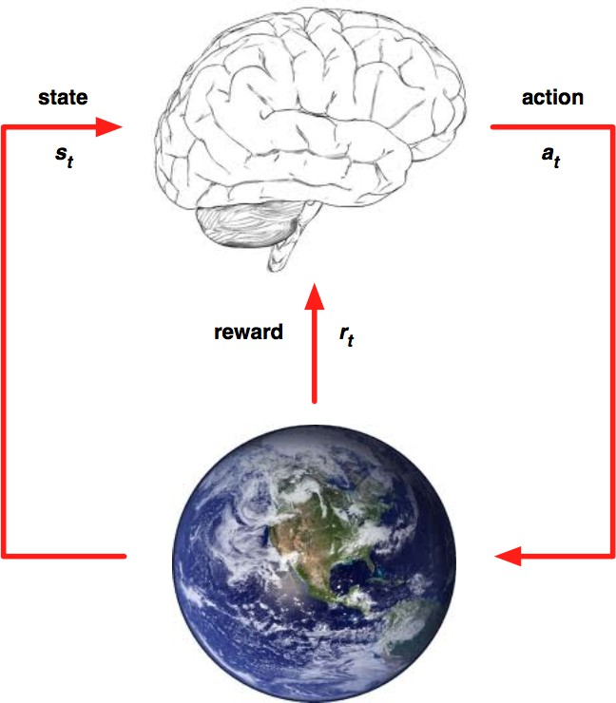
REINFORCEMENT LEARNING
General-purpose framework. At each time step an agent interacts with an environment. It: observes state; receives reward; executes action.
Goal: Select actions to maximize future reward. Reward signals may be sparse, noisy and delayed.

Slide 35
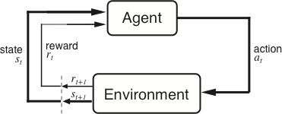
The Agent-Environment Interface
Agent and environment interact at discrete time steps Agent observes state at step t : s_{t} ∈S
: t = 0, 1, 2, K
produces action at step t : a_{t} ∈ A(s_{t} )
gets resulting reward : and resulting next state :
r_{t +1} ∈ℜ
^{s}t +1
. . .
^{r}t +1 _{st +1}
^{r}t +2 _{st +2}
^{r}t +3
. . .
s
t
a_{t}
^{s}t +3
ªt +1
ªt +2
ªt +3

Slide 36
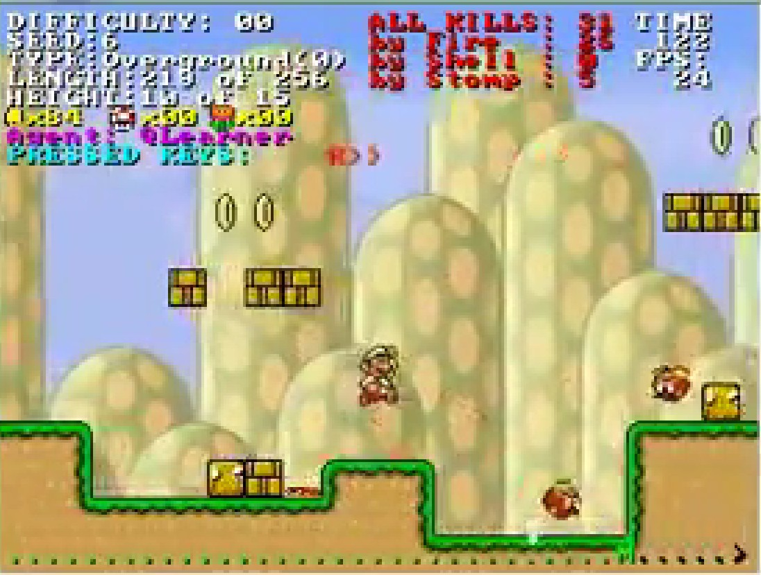
Reinforcement Learning
https://www.youtube.com/watch?v=4cgWya-wjgY

Slide 37

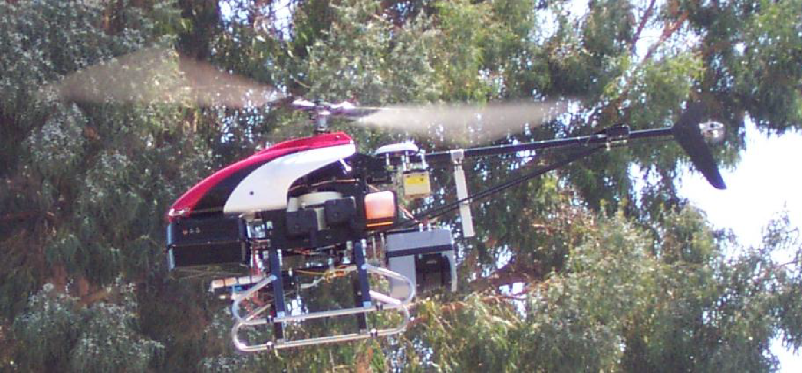
Inverse Reinforcement Learning
Learn policy from user demonstrations
Stanford Autonomous Helicopter http://heli.stanford.edu/ https://www.youtube.com/watch?v=VCdxqn0fcnE

Slide 38
Introduction to Machine Learning
ML-Basics Data

Slide 39
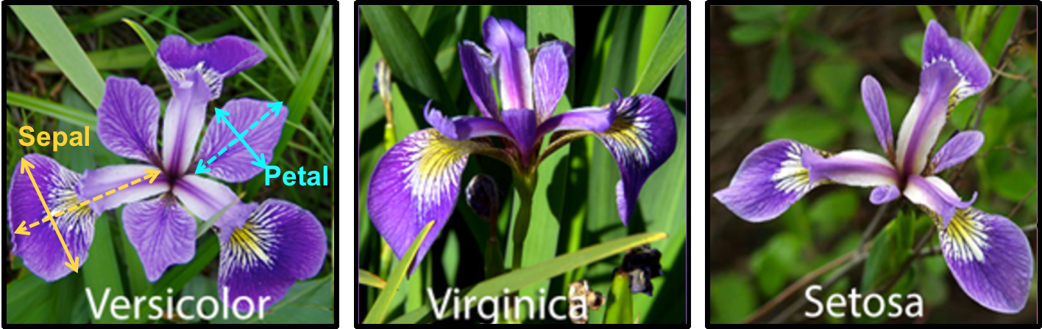
IRIS DATA SET
Introduced by statistician Fisher, frequently used toy example. Classify iris subspecies based on flower measurements 150 iris flowers: 50 versicolor, 50 virginica, 50 setosa Sepal length / width and petal length / width in [cm]
Source: https://rpubs.com/vidhividhi/irisdataeda
Word of warning: “iris” is a small, clean, low-dim data set, very easy to classify; this is not necessarily true in the wild.

Slide 40
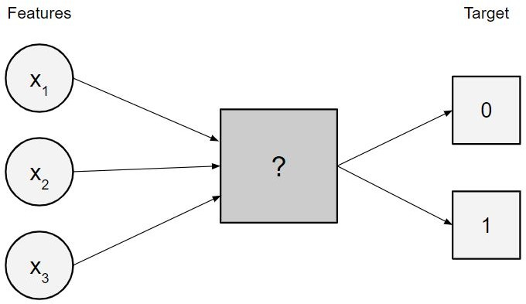

DATA IN SL
Measurements on different aspects of n objects: Target: output variable / goal of prediction Features: properties that describe the object
We assume some relationship between features and target, and want to discover that predictive rule.

Slide 41

DATA TYPES

Slide 42

ENCODING FOR CATEGORICALS

Slide 43





ENCODING FOR CATEGORICALS
[“Red", “Green", “Blue“]
["Toronto", "Vancouver", "Calgary", "Montreal"]
One-hot encoding
Dummy encoding

Slide 44

OBSERVATION LABELS
We call the entries of the target column labels. We distinguish two types of data:
Labeled data: target is observed
Unlabeled data: target is unknown

Slide 45

NOTATION FOR DATA

Slide 46

DATA-GENERATING PROCESS

Slide 47

DATA-GENERATING PROCESS / 2

Slide 48

DATA-GENERATING PROCESS / 3

Slide 49

ML-Basics: Supervised Tasks
Learning goals
Know definition and examples of supervised tasks
Understand the difference between regression and classification

Slide 50

TASKS: REGRESSION VS CLASSIFICATION

Slide 51
PREDICT VS. EXPLAIN
Learning to predict.
Goal: Get the most accurate prediction for unseen data, even if we don’t fully understand how the model works.
Example: A credit card company uses a deep neural network to predict whether a new transaction is fraudulent.
They don’t care if the model is a “black box.” What matters: when a suspicious transaction comes in, the model flags it correctly.
Learning to explain
Goal: Understand the relationship between variables, even if the model isn’t the best at prediction.
Example: A public health researcher builds a regression model to see how smoking, exercise, and diet affect life expectancy.
Even if the model isn’t great at predicting an individual’s lifespan, it shows that smoking reduces life expectancy by ~7 years on average.
Both Together
Sometimes we want both: In medical AI, a model might predict if a patient has a disease (prediction) and highlight which symptoms or biomarkers were most important (explanation).

Slide 52


REGRESSION EXAMPLE: HOUSE PRICES
Predict the price for a house in a certain area
Rather learn to explain. We might want to understand what influences a house price most. But maybe we are also looking for underpriced houses and the predictor is of direct use, too.

Slide 53


REGRESSION EXAMPLE: LENGTH-OF-STAY
Predict days a patient has to stay in hospital at time of admission
Can be learn to explain, but learn to predict would help a hospital’s planning.

Slide 54


CLASSIFICATION EXAMPLE: RISK CATEGORY
Predict one of five risk categories for a life insurance customer to determine the insurance premium
Probably learn to predict, but the company might be required to explain its predictions to its customers.

Slide 55

ML-Basics: Models & Parameters
Learning goals
Understand that an ML model is simply a parametrized function
Understand that the hypothesis space lists all admissible models
Understand relationship between hypothesis and parameter space

Slide 56

WHAT IS A MODEL?
A model (or hypothesis)
f : X → R^{g}
is a function that maps feature vectors to predicted target values. In regression: g = 1; in classification, g is the number of classes, and output vectors are scores or class probabilities.

Slide 57

WHAT IS A MODEL? / 2
f is meant to capture intrinsic patterns of the data, the underlying assumption being that these hold true for all data drawn from P_{xy} .
Models can range from super simple (e.g., linear, tree stumps) to very complex (e.g., DL). There are a lot of choices.
ML requires constraining f to a certain type of functions.

Slide 58
HYPOTHESIS SPACES
Without restrictions on the functional family, the task of finding a “good” model among all available models is impossible to solve.
We have to determine the class of our model a priori, thereby narrowing down the search space. We call this a structural prior.
The set of functions defining a specific model class is called a
hypothesis space H:
H = {f : f belongs to a certain functional family}

Slide 59

PARAMETRIZATION

Slide 60

PARAMETRIZATION / 2
Finding optimal model = finding optimal parameters.
This allows us to operationalize our search for the best model as a search for the optimal value on a d -dimensional parameter surface.
θ might be scalar or very high-dimensional with thousands of parameters, depending on the complexity of our model.

Slide 61

PARAMETRIZATION / 3
Some parameter vectors, for some model classes, encode the same function; i.e., the parameter-to-model mapping could be non-injective.
We call this a non-identifiable model. This shall not concern us here.

Slide 62

EXAMPLE: UNIVARIATE LINEAR FUNCTIONS

Slide 63

EXAMPLE: BIVARIATE QUADRATIC FUNCTIONS

Slide 64

ML-Basics Learner
Learning goals
Know formal definition of learner
Understand that a learner receives training data and outputs the best model from H

Slide 65

SUPERVISED LEARNING EXAMPLE
Imagine we want to investigate how working conditions affect productivity of employees.
It is a regression task since the target productivity is continuous.
We collect data about worked minutes per week (productivity), how many people work in the same office as the employee in question, and the employee’s salary.

Slide 66
SUPERVISED LEARNING EXAMPLE / 2
How could we construct a model from these data?
We could investigate the data manually and come up with a simple, hand-crafted rule such as:
The baseline productivity of an employee with salary 3000 and 7 people in the office is 1850 minutes.
A decrease of 1 person in the office increases productivity by 30. An increase of the salary by 100 increases productivity by 10.
→ Obviously, this is neither feasible nor leads to a good model.

Slide 67

IDEA OF SUPERVISED LEARNING
Goal: Identify the functional relationship that maps features to target.
Supervised learning means we use labeled data to learn model f . Later, we use model f to predict y for new unlabeled data.

Slide 68

LEARNER DEFINITION

Slide 69

LEARNER DEFINITION / 2

Slide 70
Framing a Learning Problem

Slide 71






Designing a Learning System
Choose the training experience
Choose exactly what is to be learned
– i.e. the target function
Choose how to represent the target function
Choose a learning algorithm to infer the target function from the experience
Training data
Learner
Environment/ Experience
Knowledge
Testing data
Performance Element

Slide 72
Training vs. Test Distribution
We generally assume that the training and test examples are independently drawn from the same overall distribution of data
– We call this “i.i.d” which stands for “independent and identically distributed”
If examples are not independent, requires
collective classification
If test distribution is different, requires
transfer learning

Slide 73
ML in a Nutshell
Tens of thousands of machine learning algorithms
Hundreds new every year
Every ML algorithm has three components:
Representation
Optimization
Evaluation

Slide 74
Various Function Representations
Numerical functions
Linear regression
Neural networks
Support vector machines
Symbolic functions
Decision trees
Rules in propositional logic
Rules in first-order predicate logic
Instance-based functions
Nearest-neighbor
Case-based
Probabilistic Graphical Models
Naïve Bayes
Bayesian networks
Hidden-Markov Models (HMMs)
Probabilistic Context Free Grammars (PCFGs)
Markov networks

Slide 75
Various Search/Optimization Algorithms
Gradient descent
Perceptron
Backpropagation
Dynamic Programming
HMM Learning
PCFG Learning
Divide and Conquer
Decision tree induction
Rule learning
Evolutionary Computation
Genetic Algorithms (GAs)
Genetic Programming (GP)
Neuro-evolution

Slide 76
Evaluation
Accuracy
Precision and recall
Squared error
Likelihood
Posterior probability
Cost / Utility
Margin
Entropy
K-L divergence
etc.

Slide 77


ML in Practice
Understand domain, prior knowledge, and goals
Data integration, selection, cleaning, pre-processing, etc.
Learn models
Interpret results
Consolidate and deploy discovered knowledge
Loop

